Slide 1

Off-Page Optimization

Slide 2
Search Engine Optimization
Off Page Optimization
Off page optimisation is defined as the technique which helps the website to improve its ranking on the search engine results page.
These factors functions outside the boundaries of the web pages. These ranking factors are not directly controlled by the publisher.
Off-page optimisation basically deals in link building for SEO.
Off page SEO is a long term and time consuming process.
It includes acquiring backlinks to your webpage from the authority sites, Social media and Social bookmarking.
Off-page optimization is not limited to link building only

Slide 3
Dimensions of off-page SEO
Dimension 1
Link Building
External Link
Dimension 2
Social Media
Dimension 3
Social Bookmarking

Slide 4
Factors to evaluate quality of web pages
Age of Domain Name - Check https://smallseotools.com/domain-age-checker/
Back Link Profile - Check https://ahrefs.com/backlink-checker
Domain Authority - Check https://chrome.google.com/webstore/detail/mozbar/eakacpaijcpapndcfffdgphdiccmpknp?hl=en
Page Authority
Page Rank - Check https://checkpagerank.net/
Follow Links and No-follow links
Quality of Content

Slide 5
Domain Authority, Page Authority & Page Rank
Domain Authority (DA) is a search engine ranking score developed by Moz. The score of domain authority predicts how well a website will rank on search engine result pages (SERPs)
Page Authority
Page Rank
Page Authority (PA) is a score developed by MOZ that predicts how well a specific page will rank on search engine result page (SERP)
1-100
Google Page rank is calculated on the basis of quality and quantity of back links. Important pages receive a higher Page Rank and are more likely to appear at the top of the search results
0-10

Slide 6
Follow link and No follow link
Link Juice
The link juice flows through sites and into new sites through hyperlinks The more reputable site, the bigger boost of link juice is transferred to the linked sites
Follow links are those links that are counted as link points and helps in boosting the ranking of sites in the SERPs
No Follow links
A no follow link is a link that does not count as a link point in the page’s favor. It does not boost PageRank, and doesn’t help a page’s placement in the SERPs.
Introduced to avoid spamming of link.
No follow link can easily be created by HTML

Slide 7
Linking Strategies
Low Hanging Fruit
Content

Slide 8
Low Hanging Fruit strategies
Directory Submission
Directory Submission
Video Submission
Profile Creation
Press release submission
Article Submission
Blog Submission
E-book Directory Submission
Blog Comment
Info graphic Submission
Press releases
Web Directories
https://www.indiamart.com/ https://www.indiabizlist.com/ https://dmoz-odp.org/ https://www.zoominfo.com/ https://botw.org/ http://www.freeprwebdirectory.com/ List of Profile Creation Sites
Profile Creation
www.clippings.me
www.forum.adobe.com
www.bloggers.com
Article submission
https://ezinearticles.com/ https://www.ehow.com/ https://www.articlecity.com/ https://hubpages.com/ https://www.articlecube.com/ More Sites

Slide 9
Blog Submission
https://www.tumblr.com/
https://www.blogger.com
https://medium.com/
http://www.soup.io/
E -Book Submission
www.getfreeebooks.com
https://www.smashwords.com/
https://www.kobo.com/in/en/p/writinglife
https://www.freebooksy.com/editorial-submissions/
https://www.ebookstage.com/
Press Releases
http://www.freepressrelease.com/
https://clickpress.com/releases/index.shtml
https://www.prlog.org/
More Press releases sites

Slide 10
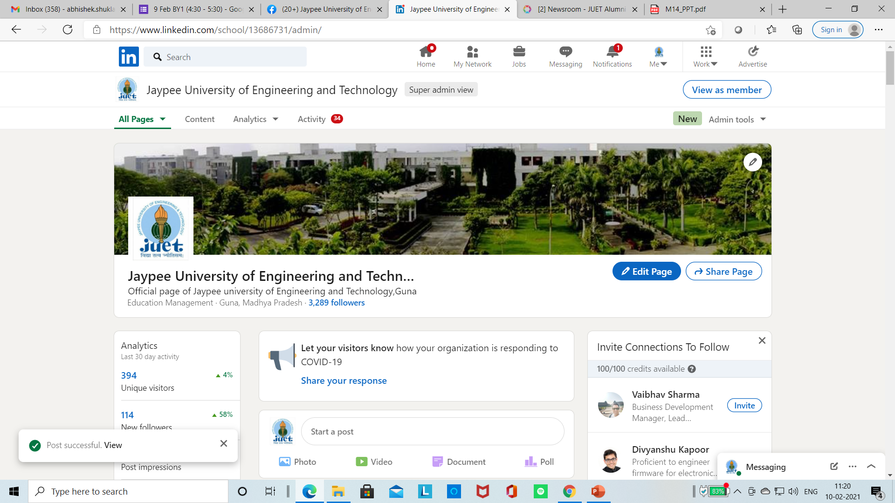
Social Media- 2nd Dimension
Social media helps in promotion of your website and business
Facebook, Instagram, Twitter, Linkedin
Use of social media by the businesses has increased many times either in the form of advertising or presence on social media through business profiles
Content Promotion
You can promote your content directly to your followers
Social Media Posts Rank high on Google
Google treats social media platforms like Facebook and Twitter just like any other web page

Slide 11
Social Media Bookmarking- 3rd Dimension
Social bookmarking is a way to save the favorite WebPages online for future use
Social bookmarking will help you to get back link from social sites by submitting your sites to them by the way of posts, images, videos etc
Google Bookmarks
LinkedIn Corporation
Vk.com
Facebook
Myspace
Pinterest
Instagram
Twitter

Slide 12
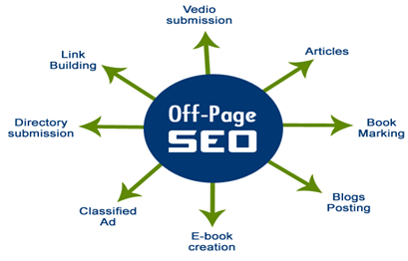
Search Engine Optimization
Off Page Optimization

Slide 13
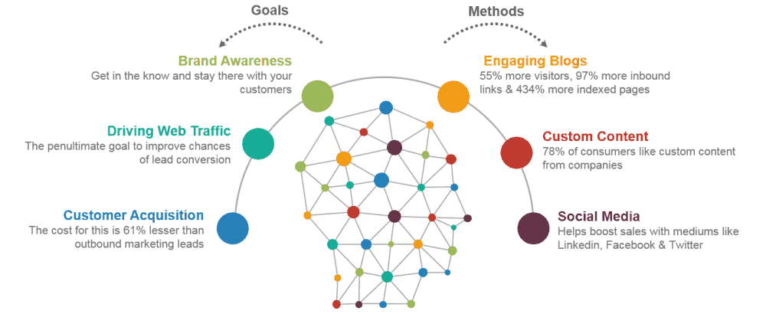
Content Marketing

